Slide 1
Uber Trip Analysis
Name: Harsha Chakravarthy Bellamkonda
Date: March 2025

Slide 2
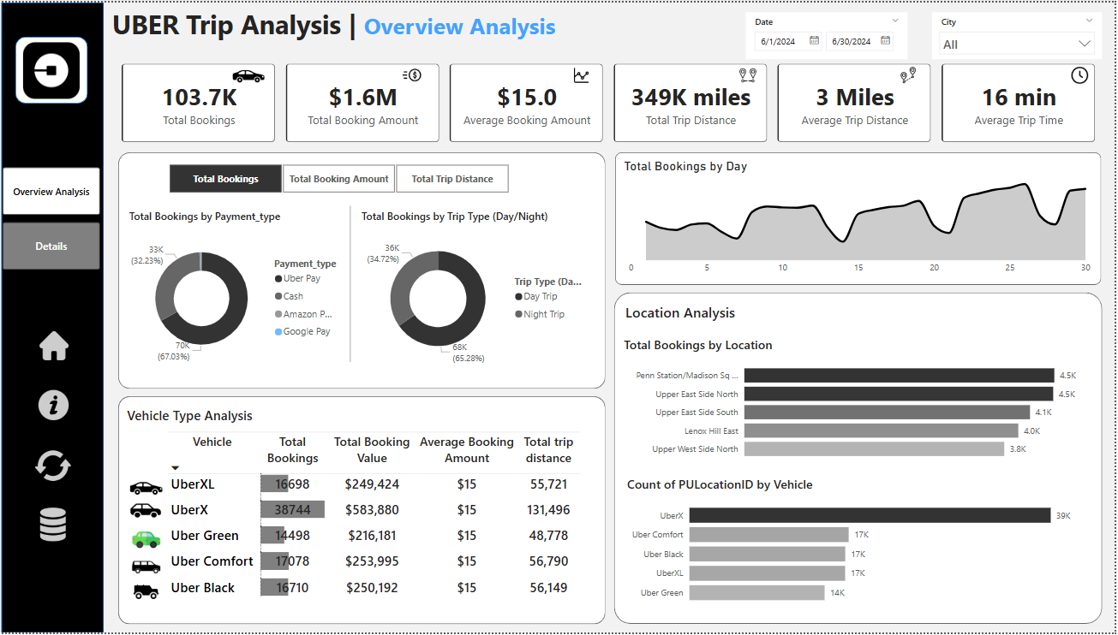
Dashboard:

Slide 3
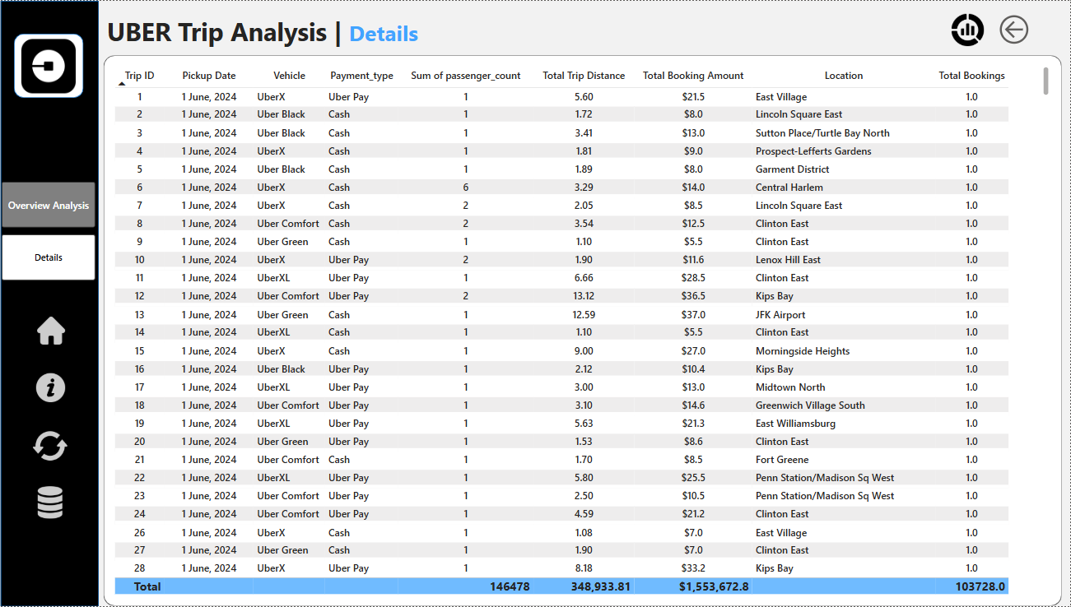
Dashboard:

Slide 4
Introduction:
Project Objective:
Analyze Uber trip data to uncover insights on ride trends, customer behavior, and financial patterns.
Utilize Power BI for data visualization and business intelligence.
Dataset Overview:
Trip details (Pickup/Drop-off, Distance, Fare, Payment Type)
Location data (City, Location IDs & Location)
Tools Used:
Power BI, Excel

Slide 5
Data Preprocessing & Cleaning:
Steps Taken:
Removed missing or duplicate records.
Standardized location data using the Location Table.
Converted date-time columns into proper formats for analysis.
Connected datasets to map location IDs to actual city names.
Challenges:
Inconsistent data entries in location names.
Missing values in trip distance and fare amount.

Slide 6
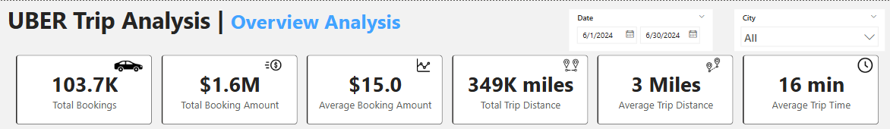
Key Performance Indicators (KPIs):
Total Bookings: 103.7K
Total Booking Amount: $1.6M
Average Booking Amount: $15
Total Trip Distance: 349K miles
Average Trip Distance: 3 miles
Average Trip Duration: 16 minutes

Slide 7
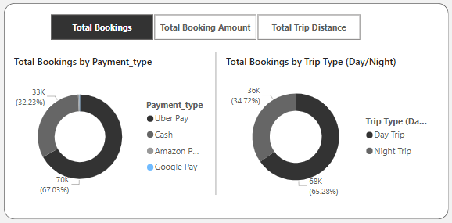
Customer Behavior Analysis:
Trip Trends:
Peak booking times by hour & day.
Most frequent pickup & drop-off locations.
Payment Preferences:
67% of users prefer Uber Pay, followed by Cash (32%) and other methods.
Day vs. Night Trips:
68% of trips happen at Day, indicating high demand during day hours.

Slide 8
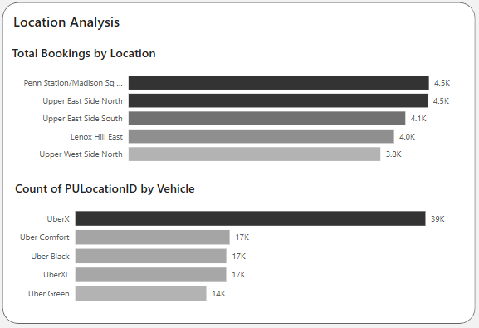
Location-Based Insights:
Top Pickup & Drop-off Locations:
Penn Station / Madison Sq Garden
Upper East Side South & North
Lenox Hill East
City-Wise Trends:
The majority of bookings come from business districts & entertainment hubs.
Surge pricing is highest in areas with high demand during peak hours.

Slide 9
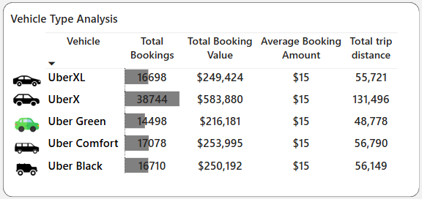
Revenue & Business Impact:
Revenue Insights:
UberX contributes the highest revenue with $583,880.
UberXL has the bookings but a lower per-trip revenue.
Pricing Strategy:
Surge pricing affects 30% of trips, leading to higher revenue.
Short trips contribute significantly to overall earnings.

Slide 10
Conclusion & Recommendations:
Findings:
Most bookings occur during peak hours and weekends.
Uber Pay is the preferred payment method.
Business districts and entertainment hubs have the highest ride density.
Recommendations for Uber:
Optimize surge pricing strategies for high-demand areas.
Improve ride-sharing promotions for short-distance trips.
Expand incentives for non-cash payment users to speed up transactions.
Next Steps:
Deploy real-time dashboards for dynamic ride trend monitoring.
Incorporate machine learning models for demand forecasting.

